Slide 1
Intelligent Agents
Spring 2024
Lec # 3
Bushra Rashid
Russell & Norvig: Chapter 2; Section2.1-2.4

Slide 2
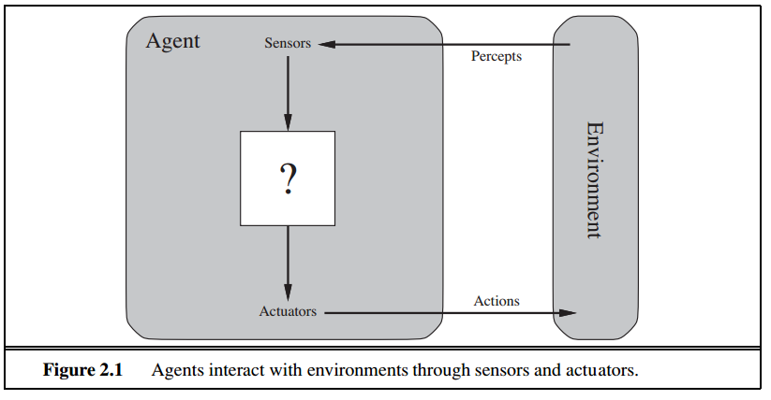
Agents and Enviorments
In this course we will focus on Rational Agents
An agent is just something that acts (agent comes from the Latin agere, to do).
An agent is a software or system that is designed to act autonomously and perform specific tasks
• It perceives its environment through sensors and acts upon that environment through actuators

Slide 3
Agents and Enviorments
Human: sensors are eyes, ears; actuators (effectors) are hands, legs, mouth
Software Agent
sensory input: keystrokes, file contents, and network packets
Actuator: acts on the environment by displaying on the screen, writing files, and sending network packets

Slide 4
percept refer to the agent’s perceptual inputs at any given instant.
PERCEPT SEQUENCE: agent’s percept sequence is the complete history of everything the agent has ever perceived.
an agent’s choice of action at any given instant can depend on the entire percept sequence observed to date, but not on anything it hasn’t perceived.
AGENT FUNCTION
agent’s behavior is described by the agent function that maps any given percept sequence to an action
external characterization of the agent
AGENT PROGRAM- is an internal implementaion of the agent function for an artificial agent
The agent function is an abstract mathematical description; the agent program is a concrete implementation, running within some physical system.

Slide 5
How to describe an Agent
What is the Environment?
What type of Sensors it requires?
Which Actuators are required?
What Percepts it is getting via sensors from environment?
Percept Sequence
Agent Function (map percepts or percept sequence to action)?
Agent Program
Performance Measure: that evaluated the effect of actions

Slide 6
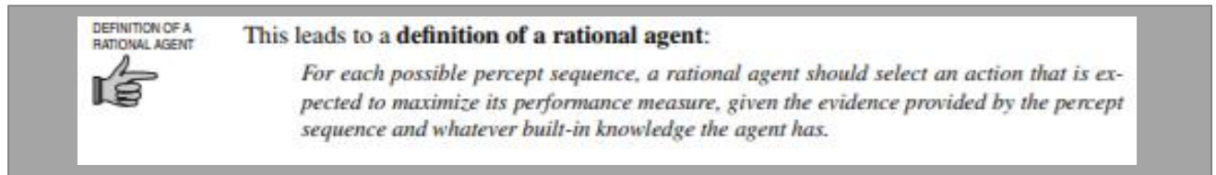
INTELLIGENT AGENT
A rational agent is one that acts so as to achieve the best outcome or, when there is uncertainty, the best expected outcome
Rationality:
• The performance measure that defines criterion of success
• The agent prior knowledge of the environment
• The actions that agent can perform
Notes:
An agent is anything that can be viewed as perceiving its environment through sensors and acting upon that environment through actuators.

Slide 7
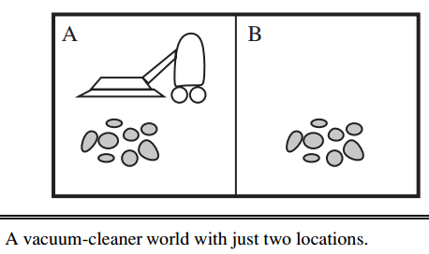
Example of Agent
Agent: Vacuum Cleaner
Environment: Area A and B
Sensor: Camera
Percept: Area clean or not
Actuator:
Action: Move left, Move Right,
Start cleaning
Agent Function: on next slide
Performance Measure?: Award one point for each clean square at each time step, over a lifetime of 1000 time steps
Notes:
it can percives two things:which square it is in and whether there is dirt in the square
What will the agent do after all dirt is cleaned up? Oscillate back and forth

Slide 8
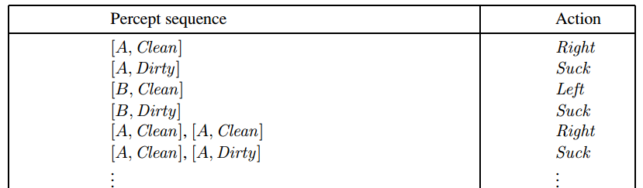
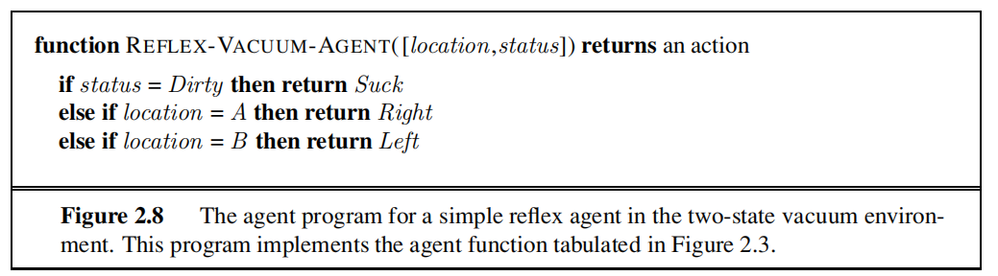
Agent Function

Slide 9
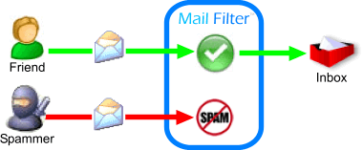
Example of Agent
Agent: Email Spam filter
Environment: Inbox
Sensor:
Percept: Email
Actuator:
Action: Move email to spam or inbox
Agent Function: Classification Model
Performance Measure: Accuracy, Precision, Recall
Notes:
Precision and recall
In pattern recognition, information retrieval and binary classification, precision (also called positive predictive value) is the fraction of relevant instances among the retrieved instances, while recall (also known as sensitivity) is the fraction of relevant instances that have been retrieved over the total amount of relevant instances. Both precision and recall are therefore based on an understanding and measure of relevance.

Slide 10
Specifying the Task Enviorment:
In designing an agent, the first step must always be to specify teh task envirnment as fullt as possible
Task enviornment is the description of Performance, Enviorment, Actuators, and sensors(PEAS)

Slide 11
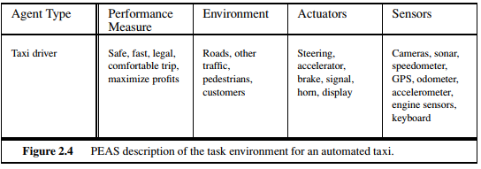
PEAS

Slide 12
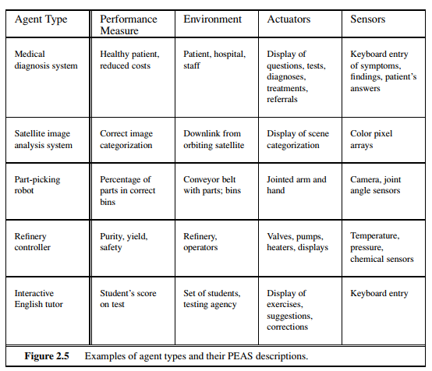
Some More Examples

Slide 13
Properties of Task Environment
Fully observable vs. Partially observable
Deterministic vs. stochastic
Episodic vs. Sequential
Static vs. Dynamic
Discrete vs. Continuous
Single vs. Multivalent
Notes:
Fully observable vs. Partially observable: Complete state of environment is observable
Deterministic vs. stochastic: next state is completely determined by the current action
Episodic vs. Sequential: Agents experience is divided into atomic episodes, agent perceives and performs single action based on only current state.
Static vs. Dynamic: If environment changes while agent is deliberating (semi-dynamic when environment doesn’t change but score of agent changes with passage of time)
Discrete vs. Continuous
Single vs. Multivalent

Slide 14
Properties of Task Environments
Fully observable vs. Partially observable
If an agent’s sensors give it access to the complete state of the environment at each point in time, then we say that the task environment is fully observable.
Fully observable environments are convenient because the agent need not maintain any internal state to keep track of the world
Chess- the board and the opponent’s movementa are fully obseravable.
An environment might be partially observable because of noisy and inaccurate sensors or because parts of the state are simply missing from the sensor data—for example, a vacuum agent with only a local dirt sensor cannot tell whether there is dirt in other squares, and an automated taxi
If the agent has no sensors at all then the environment is unobservable.

Slide 15
Properties of Task Environments
Deterministic vs. stochastic
If the next state of the environment is completely determined by the current state and the action executed by the agent, then we say the environment is deterministic; otherwise, it is stochastic
Stochastic systems, involve a certain degree of randomness or probability.
Strategic systems refers to decision making process where the decision maker take into account the potential actions of other decision makers and their potential reactions to the decision maker's own actions.
Taxi driving: stochastic (behavior of traffic cannot be determined)
Chess-in its current state, a coin has just a few alternative moves, and these moves can be determined
Vacuum cleaning: deterministic
Variations may include stochastic elements such as randomly appearing dirt and an unreliable suction

Slide 16
Properties of Task Environments
Single Vs. Multiagents
Solving crossword puzzle vs chess playing
For Multi-Agents: Competitive (in Chess)
cooperative multi-agent env (in driving to avoid collision)
Partially competitive: only one car can occupy a parking space

Slide 17
Properties of Task Environments
Episodic vs. sequential
In each episode, the agent receives a percept and then performs a single action that doesn’t depend on the actions taken in previous episodes.
classification task
an agent that has to spot defective parts on an assembly line bases each decision on the current part, regardless of previous decisions
In sequential environments, the current decision could affect all future decisions
Chess and taxi driving are sequential: in both cases, short-term actions can have long-term consequences

Slide 18
Properties of Task Environments
Static vs. dynamic
If the environment can change while an agent is deliberating, then we say the environment is dynamic for that agent; otherwise, it is static
Taxi driving is clearly dynamic
Chess, when played with a clock,is semidynamic
Crossword puzzles are static
Discrete vs. continuous
The discrete/continuous distinction applies to the state of the environment, to the way time is handled, and to the percepts and actions of the agent
Discrete has finite countable states: chess is discrete
Taxi-driving is continuous-state, and continuous-time problem: the speed and location of the taxi and of the other vehicles sweep through a range of continuous values and do so smoothly over time. Taxi-driving actions are also continuous (steering angles, etc.)

Slide 19
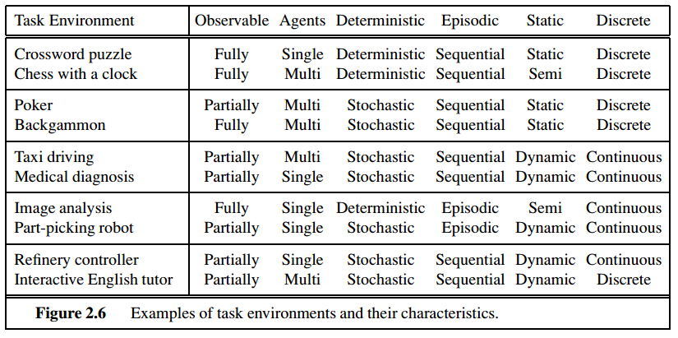
hardest case is partially observable, multiagent, stochastic, sequential, dynamic, continuous, and unknown

Slide 20
Four kinds of Agents
Simple Reflex Agent
act only on current percept.
Model Based Reflex Agent.
How the world works. Percept sequence.
Goal based Agent
Act to fulfill some goal.
Utility agent
Act to maximize a utility function.
Learning Agent
Learn from environment and feed back on actions

Slide 21
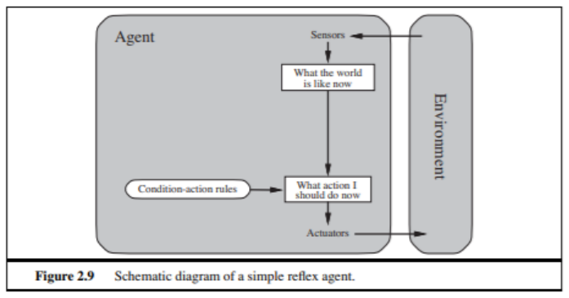
Simple Reflex Agent
Act only on the basis of current percept
Use simple “if then” rules also called condition action rule
Can be short sighted
These agents select actions on the basis of the current percept, ignoring the rest of the percept history.
Enviorment should be fully observable

Slide 22
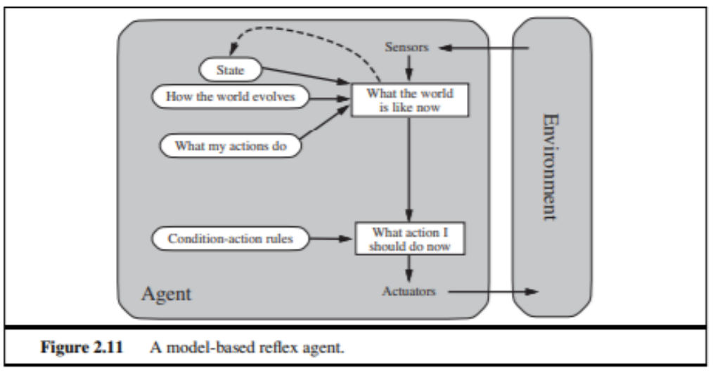
Model based reflex Agent
Store previously-observed information (percept history)
Can reason about unobserved aspects of current state
partially observable enviorment

Slide 23
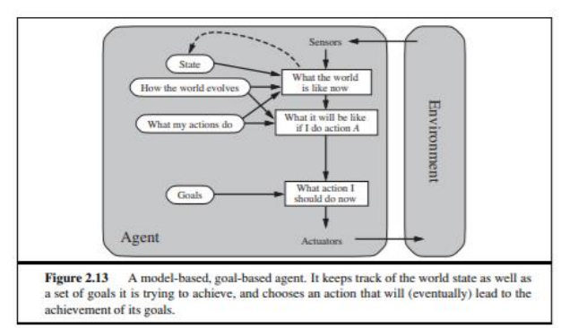
Goal-based Agent
Goal reflects desires of agents
May project actions to see if consistent with goals
Takes time, world may change during reasoning
They have specific goals or objectives that they try to achieve, and they take actions based on the current percepts and their internal state to reach those goals

Slide 24
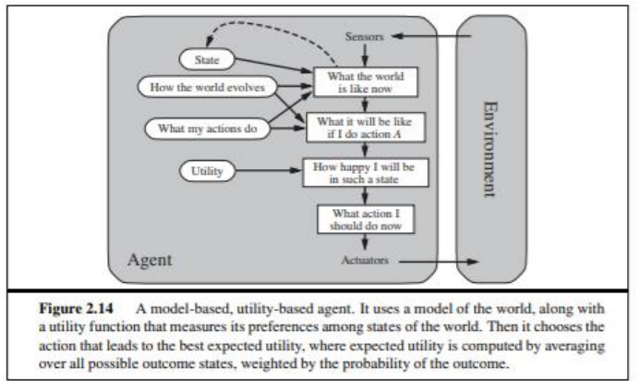
Utility-based Agent
Goals alone are not enough to generate high-quality behavior in most environments
Utility is a measure of the value or desirability of a particular state or outcome. The agent uses utility to determine the actions it should take in order to achieve its goals.
They take into account the long-term consequences of their actions to maximize a specific utility function

Slide 25
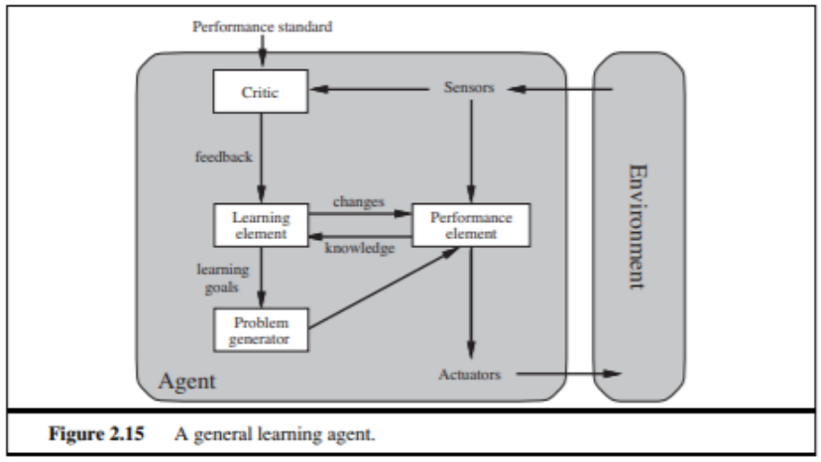
Learning Agent
They are able to improve their performance over time by learning from their experiences and adjusting their behavior accordingly
The agent uses past experiences and feedback to continuously improve its decision-making and problem-solving abilities.

